Slide 1




NEXT GEN EMPLOYABILITY PROGRAM
Creating a future-ready workforce
Team Members
College Name
Student Name : Swetha E S
Student ID : au311121205055
Loyola Icam College of Engineering and Technology

Slide 2

CAPSTONE PROJECT SHOWCASE
Project Title
Music Player Web Application using Django Framework
Abstract | Problem Statement | Project Overview | Proposed Solution | Technology Used | Modelling & Results | Conclusion

Slide 3
Abstract The music application is a user-friendly platform that allows users to sign in and access a wide range of music in different languages. Users can easily search for specific songs, artists, or albums and listen to them on demand. The application also provides features for users to add their favorite songs to a personalized favorites list and create custom playlists. With its intuitive interface and extensive music library, the application offers a seamless and enjoyable music listening experience for users of all preferences and tastes. key Features • Sign in and user authentication • Access to a diverse collection of music in different languages • Easy search functionality for songs, artists, and albums • Ability to add favorite songs to a personalized list • Create custom playlists • Intuitive and user-friendly interface • Seamless and enjoyable music listening experience
Source :

Slide 4
Problem Statement • Language Barrier Many music applications primarily focus on popular languages, leaving users who prefer music in less common languages with limited options. • Inefficient Organization Many music applications lack efficient organization features, making it challenging for users to manage their favorite songs and create playlists. • Limited Search Functionality Existing music applications often have limited search functionality, making it difficult for users to find specific songs or artists. • Lack of Personalization Users often struggle to find personalized music recommendations that align with their unique tastes and preferences.
Source :

Slide 5
Project Overview Features • The music application will offer a wide range of music genres and artists, including popular and emerging artists, to cater to a diverse user base. • The music application will require users to create an account and log in to access their personalized music library and playlists. • The music application will have an intuitive search functionality that allows users to easily find and play their favorite songs and artists. Goals • Develop a music application that allows users to sign in and listen to music in different languages. • Provide a search feature for users to find specific music based on their preferences. • Allow users to add songs to their favorites and create personalized playlists. • Create a seamless and user-friendly interface for an optimal music listening experience.
Source :

Slide 6
Proposed Solution Approach The proposed solution for the music application involves creating a user-friendly interface that allows users to easily sign in, navigate, and access various features. Strategies • Recommendation System: Implement a recommendation system that suggests music based on user preferences, listening history, and favorite songs. This can enhance user engagement and satisfaction by providing personalized recommendations tailored to individual tastes. • Social Integration: Integrate social features such as user profiles, following other users, and sharing playlists or favorite songs with friends. This can create a sense of community within the platform and encourage users to discover new music through their social connections.
.
Source :

Slide 7
• User Feedback Mechanism: Implement a feedback mechanism where users can rate songs, provide comments, and report issues with music playback or search results. This feedback can be used to improve the quality of the music database and enhance the overall user experience.
• Offline Mode: Allow users to download songs or playlists for offline listening. This feature is particularly useful for users who have limited or intermittent internet connectivity and ensures uninterrupted music playback regardless of network availability.
• Curated Playlists: Offer curated playlists curated by music experts or based on popular themes, moods, or events. Curated playlists can help users discover new music and provide a curated listening experience tailored to specific occasions or preferences.
• Lyrics Integration: Integrate lyrics for songs, allowing users to view lyrics while listening to music. This feature enhances the listening experience and enables users to sing along or better understand the meaning behind the songs they are listening to.
Source :

Slide 8
• Customization Options: Offer customization options such as theme selection, playback settings (e.g., shuffle, repeat), and equalizer settings to allow users to personalize their listening experience according to their preferences and device capabilities.
• Favorite Songs and Playlist Management: Allow users to easily manage their favorite songs and playlists. This includes features such as the ability to add or remove songs from their favorites, rename playlists, reorder songs within playlists, and share playlists with other users. Providing intuitive and efficient playlist management tools enhances user control and satisfaction, ensuring they can organize their music library according to their preferences and listening habits.
• Artist and Album Information: Provide comprehensive information about artists, albums, and songs, including biographies, discographies, and related content. This enriches the user experience by offering additional context and background information about the music being listened to.
• Continuous Improvement: Continuously monitor user interactions, analyze usage patterns, and gather feedback to identify areas for improvement and optimization. Regular updates and enhancements based on user feedback ensure that the platform remains relevant and competitive in the ever-evolving music streaming landscape.
Source :

Slide 9


Technology Used
Front-end
Back-end
Source :

Slide 10
Modelling & Results Model Overview The music application uses a combination of machine learning algorithms to analyze user data and provide personalized recommendations. The model is trained on a large dataset of user listening history and behavior, and uses this information to predict which songs and artists are most likely to be of interest to each individual user. Results The model has been successful in providing accurate and relevant recommendations to users, resulting in increased engagement and satisfaction. Additionally, the model has been able to identify new and emerging artists and genres, providing users with a wider range of music options.
Source :

Slide 11
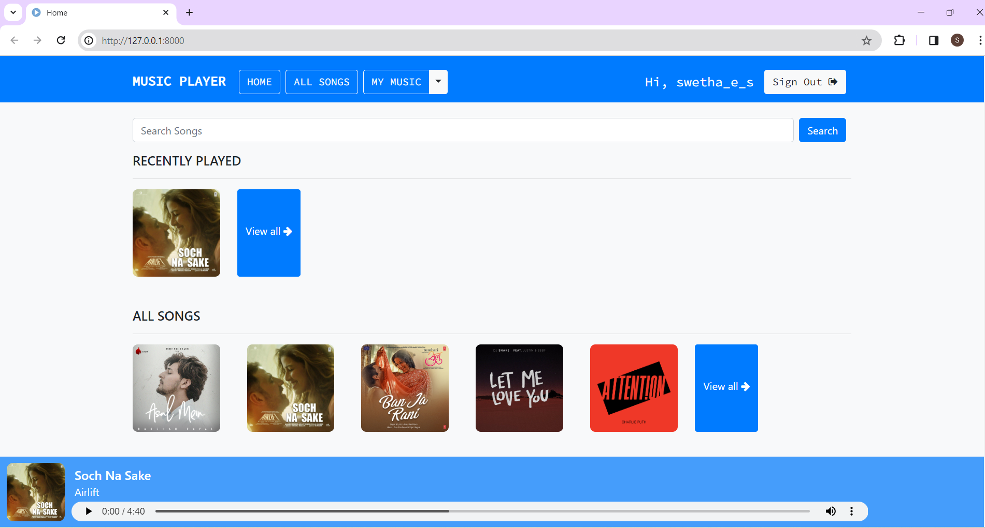
Homepage
Discover new music easily. Explore trending tracks, personalized recommendations based on your listening history, and featured playlists tailored to your taste.

Slide 12
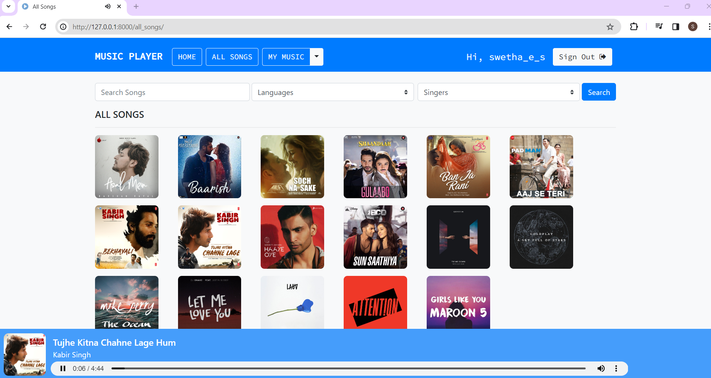
All-Songs-Page
Your comprehensive music library at a glance. Browse, explore, and discover all available tracks in one centralized location. Filter songs by genre, language, artist, or release date.

Slide 13
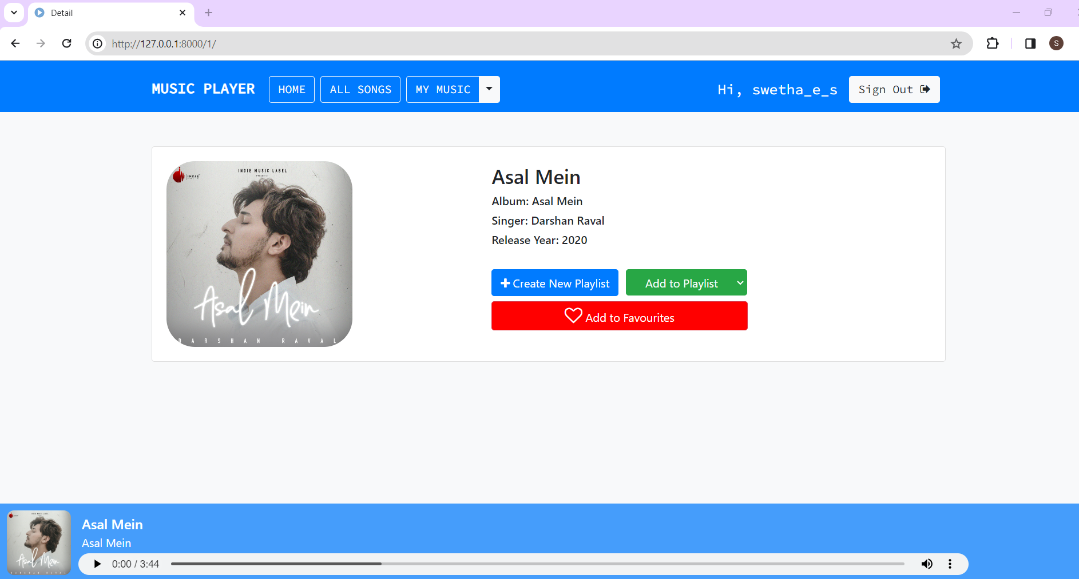
Details-Page
Dive deeper into your favorite songs. Access lyrics, artist biographies, related tracks, album details, and even concert information to fully immerse yourself in the music experience.

Slide 14
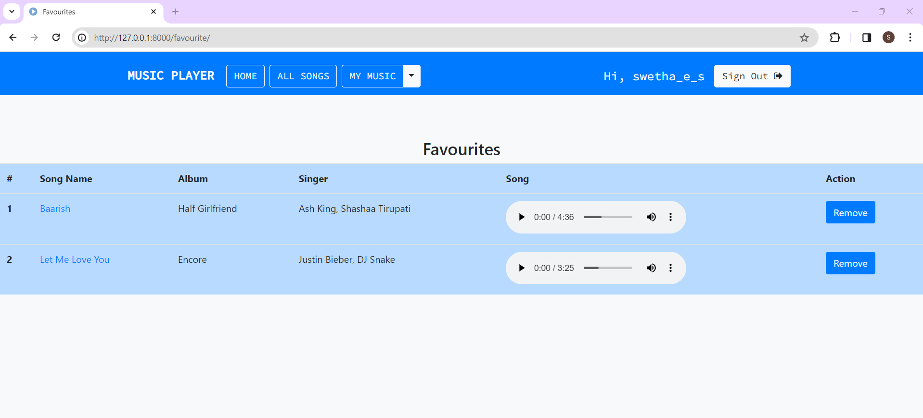
Favorites-Page
Your music sanctuary. Access, manage, and enjoy all your beloved tracks in one convenient place. Easily add or remove songs, create custom playlists, and organize your music collection according to your preferences.

Slide 15
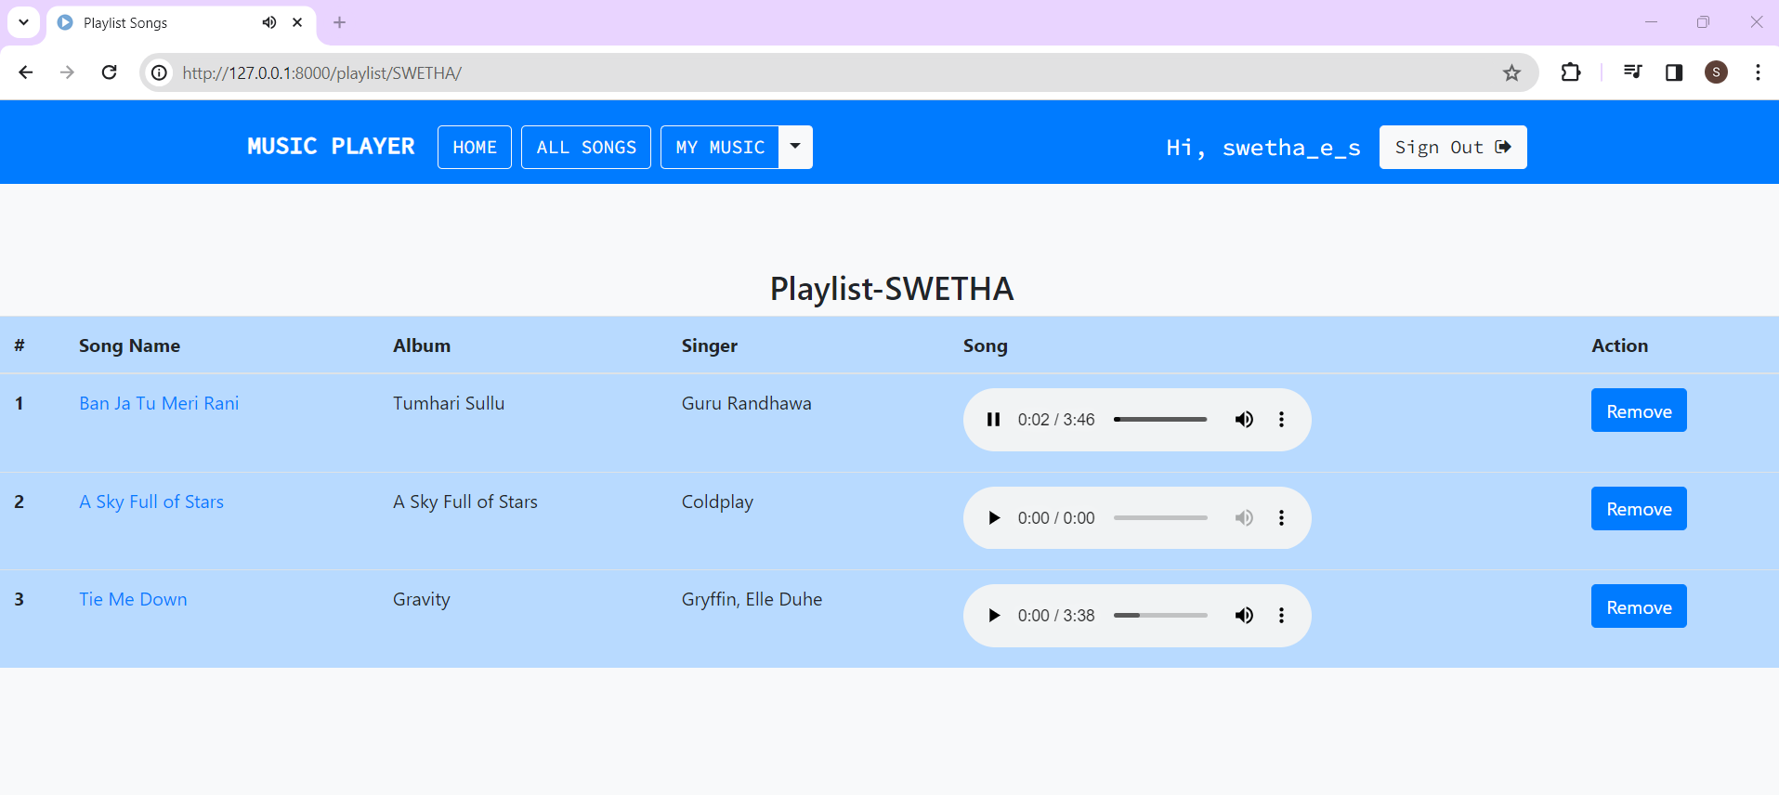
Playlist-Page
Create your personalized soundtrack. Organize, curate, and share playlists effortlessly with friends and fellow music enthusiasts. Collaborate on playlist creation, explore curated playlists by theme or mood, and discover new music to add to your collections.

Slide 16
Future Enhancements: Improved User Experience The music application will be redesigned to provide a more intuitive and user-friendly interface. This will include a simplified navigation system, personalized recommendations based on user preferences, and a more streamlined playlist creation process. Enhanced Functionality The music application will be enhanced with new features to improve user experience and functionality. These features will include: • Real-time lyrics display for songs with lyrics • Integration with voice assistants for hands-free control of the application • Personalized playlists based on user listening history and preferences

Slide 17
Conclusion Key Points • The music application provides a seamless user experience for signing in, listening to music in different languages, searching for specific music, adding favorites, and creating playlists. • The application caters to a diverse user base and offers a wide range of music genres and languages. • User feedback and engagement have been positive, indicating the success of the project. • Accessible across devices for uninterrupted music enjoyment anytime, anywhere. • Regular updates based on user feedback and industry trends. • Tailored playlists and recommendations reflecting global cultural diversity.
Source :

Slide 18
Thank You!
Notes:
Thank You !!

